Slide 1



Smart Irrigation Water Storage System
Team: The TechBuds
Team Members:
Pawan Kumar – IT 2nd Year
Lalit Kumar – IT 2nd Year
Subham Saini – IT 2nd Year
Sahib – ECE 2nd
Guided By:
Mr. Akshay Kothuri
Mr. Mahankali Surya Tej

Slide 2
Introduction
It Decreases the water wastage.
Automatic Closes Tap when Water Tank is full.
Automates the Irrigation Process as well.
It also helps in weather monitoring and Irrigates plants accordingly.
It measures Temperature, Humidity, Water Level and Soil Moisture and Send them to IBM Cloud which inturn sends data to Mobile app.

Slide 3
Objective
To save water and reduce human intervention in the agriculture field.
Continuously Monitoring the status of sensors and provide signal for taking necessary action.
To get the output of soil moisture sensor and provide water to crop.
To observe other parameters for better yield.
Sends Temperature, Humidity, Water Level and Soil Moisture readings to user.

Slide 4
Hardware Used
Arduino Genuino Uno
Node MCU
Ultrasonic Sensor
2 Servo Motor
Moisture Sensor
Pressure Sensor (BMP180)
Temperature and Humidity Sensor (DHT11)
Jumper Wires

Slide 5
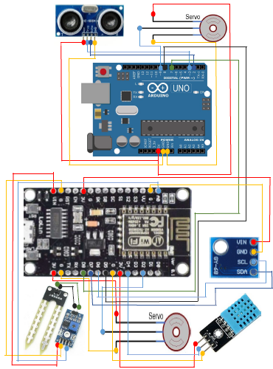
Circuit Diagram

Slide 6
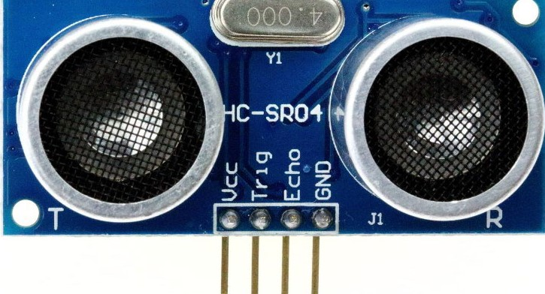
Sensors Used
Ultrasonic Sensor
HC-SR04 Ultrasonic (US) sensor is a 4 pin module, and pins are
VCC, Trigger, Echo and Ground
This sensor is a very popular sensor used in many applications where measuring distance or sensing objects are required.
The module has two eyes like projects in the front which forms the Ultrasonic transmitter and Receiver. The sensor works with the simple high school formula that
Distance = Speed × Time
The Ultrasonic transmitter transmits an ultrasonic wave, this wave travels in air and when it gets objected by any material it gets reflected back toward the sensor this reflected wave is observed by the Ultrasonic receiver module.

Slide 7
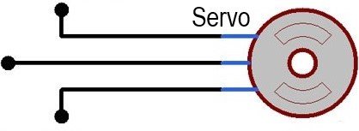
Servo Motor
You can connect small servo motors directly to an Arduino to control the shaft position very precisely.
Because servo motors use feedback to determine the position of the shaft, you can control that position very precisely.
Servo motors are small in size, and because they have built-in circuitry to control their movement, they can be connected directly to an Arduino.
Most servo motors have the following three connections:
Black/Brown ground wire.
Red power wire (around 5V).
Yellow or White PWM wire.

Slide 8
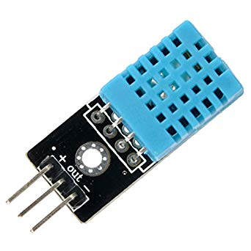
DHT11 Sensor
DHT11 Sensor is used to measure temperature and humidity.
The DHT11 detects water vapor by measuring the electrical resistance between two electrodes.
When water vapor is absorbed by the substrate, ions are released by the substrate which increases the conductivity between the electrodes.
The change in resistance between the two electrodes is proportional to the relative humidity.
The DHT11 measures temperature with a surface mounted NTC temperature sensor (thermistor) built into the unit.

Slide 9
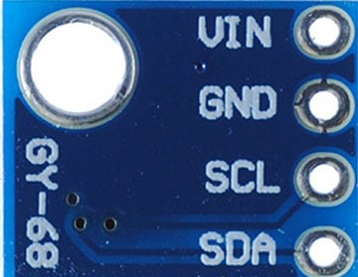
BMP180 Sensor
This precision sensor from Bosch is the best low-cost sensing solution for measuring barometric pressure and temperature.
Because pressure changes with altitude you can also use it as an altimeter!
The sensor is soldered onto a PCB with a 3.3V regulator, I2C level shifter and pull-up resistor.
This board is 5V compliant.
A 3.3V regulator and a i2c level shifter circuit is included so you can use this sensor safely with 5V logic and powers on the I2C pins.

Slide 10
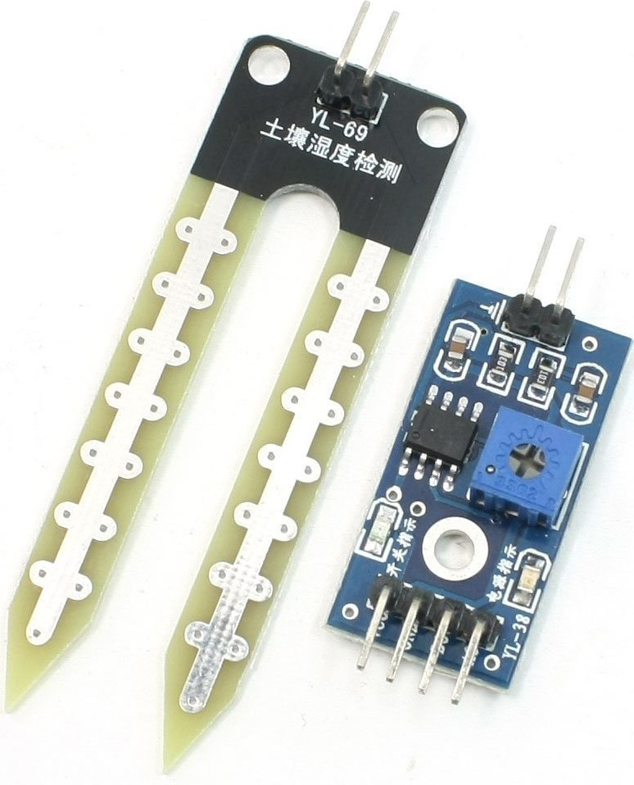
Soil Moisture Sensor (YL-38 & YL-69)
The soil moisture sensor or the hygrometer is usually used to detect the humidity of the soil.
The sensor is set up by two pieces: the electronic board and the probe with two pads, that detects the water content.
The voltage that the sensor outputs changes accordingly to the water content in the soil.
When the soil is:
Wet: the output voltage decreases
Dry: the output voltage increases
The YL-39 module has 4 pins:
VCC: 3.3-5V
GND
A0: analog output that can be easily read by Arduino
D0: digital pin that goes LOW or HIGH depending on a preset value.

Slide 11
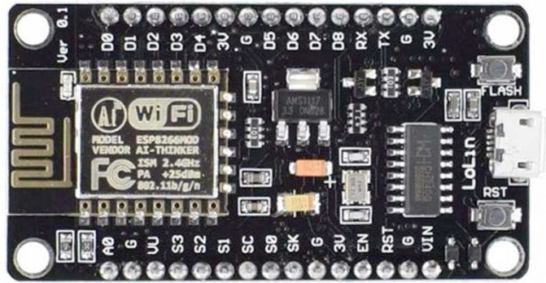
Microcontroller & Data Transmission
NODE MCU
NodeMCU is an open source IoT platform. Which includes firmware which runs on the ESP8266 Wi-Fi Module from Espressif Systems,and hardware which is based on the ESP-12 module.
The term “NodeMCU” by default refers to the firmware rather than the dev kits
NodeMCU is a Firmware on ESP8266.

Slide 12
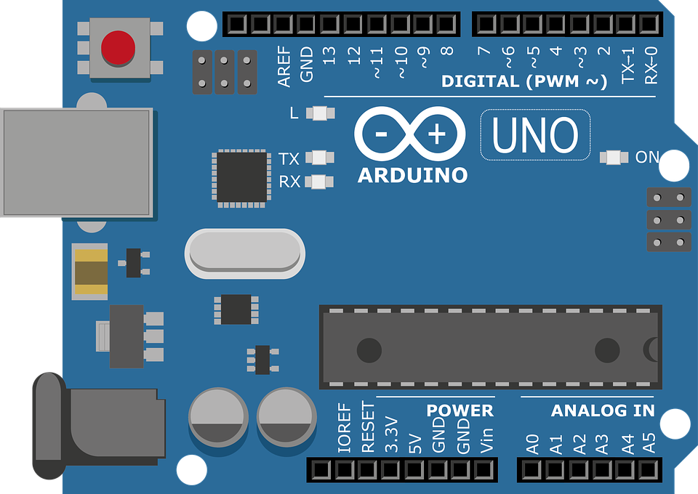
Microcontroller
Arduino Genuino Uno
Arduino is an open-source platform used for building electronics projects.
Arduino consists of both a physical programmable circuit board (often referred to as a microcontroller) and a piece of software, or IDE (Integrated Development Environment) that runs on your computer, used to write and upload computer code to the physical board.

Slide 13
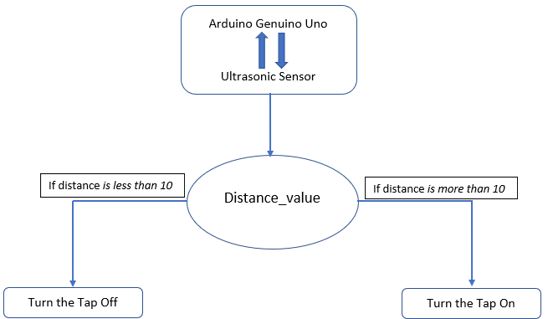
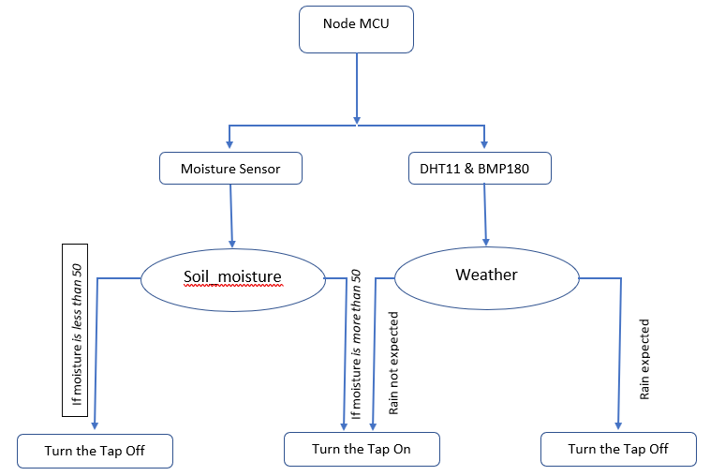
Flow Chart

Slide 14
How it Works
This project uses Arduino which in turn is connected to ultrasonic sensor which provides the water level in the water tank and sends this data to esp8266-12.
Nodemcu is connected to soil moisture sensor to measure the moisture in the soil and DHT11 and BMP180 to predict the weather.
Two solenoid valves are connected to close the water supply tank is full or whenever the soil moisture is enough.
Esp8266 is used to send data to internet (IBM Cloud) by using the MQTT protocol.
Then, after those values on the IBM Cloud are shown on a android app.

Slide 15
Advantages & Disadvantages
Advantages:-
Helps in saving Time.
Water saving
Better for plant growth
Whether prediction
Easy to maintain
Easy to Establish set up
Disadvantages:-
Continuous power supply required
Need internet and wi-fi services
Need some area for storage tank
Need some basic knowledge of technology

Slide 16
Conclusion
The smart irrigation water storage system is feasible and cost effective for optimizing water resources and for agricultural production.
This irrigation system allows cultivation in places with water scarcity thereby improving sustainability.
It proves that the use of water can be diminished.
Reduces the Human effort for water supply monitoring and while irrigation of plants.

Slide 17
Thank You

